Slide 1


Algorithm
&
Data Structure
TEB1113/TDB1023
LAB SESSION 4
Linked List

Slide 2
LEARNING OUTCOMES
Students should be able to:
understand the concept of Linked List.
understand how to perform the basic operation on Linked (add, remove, traverse sort and count).

Slide 3
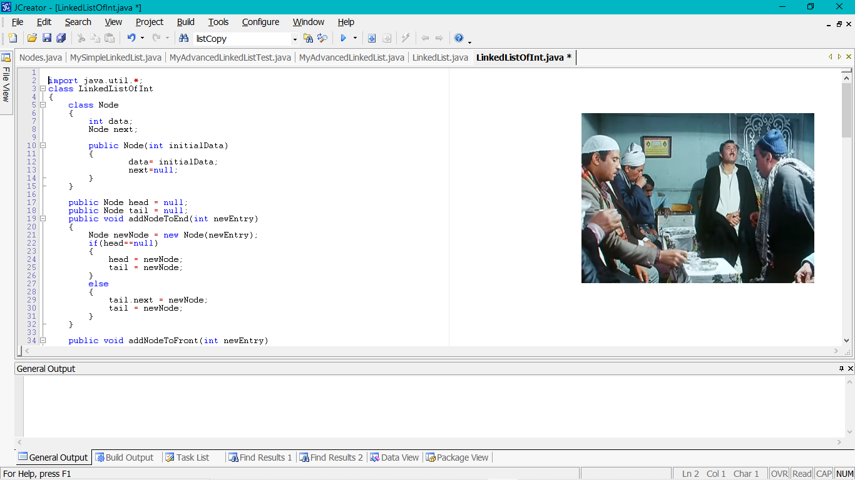
Node Class (definition)

Slide 4
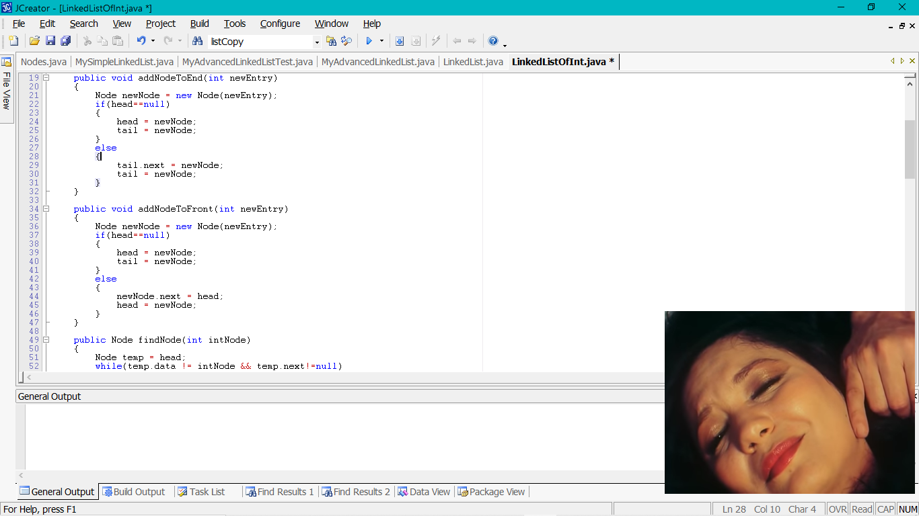
Add Node to the front of the linked list

Slide 5
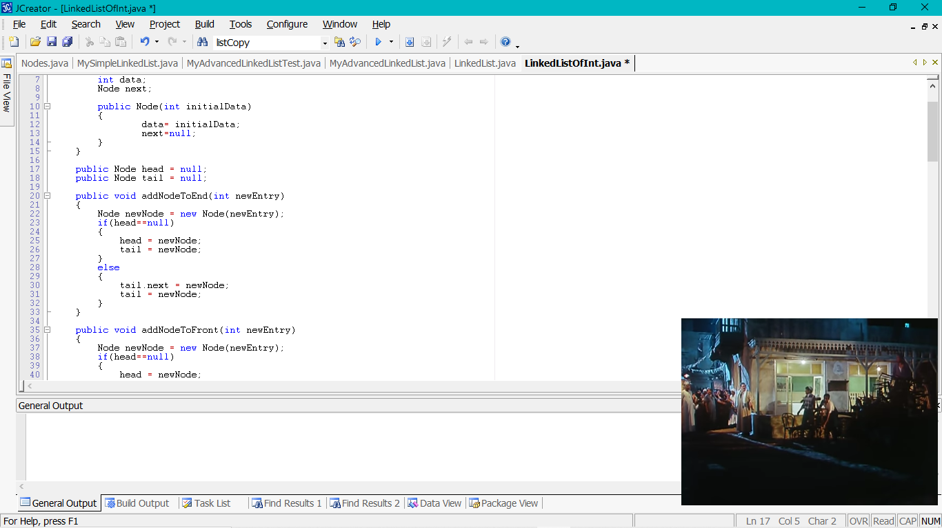
Add Node to the End of the linked list

Slide 6
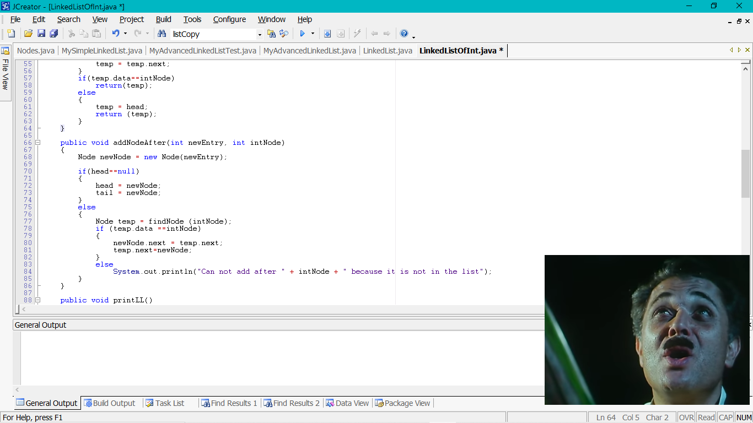
Add Node after specific element in the linked list

Slide 7
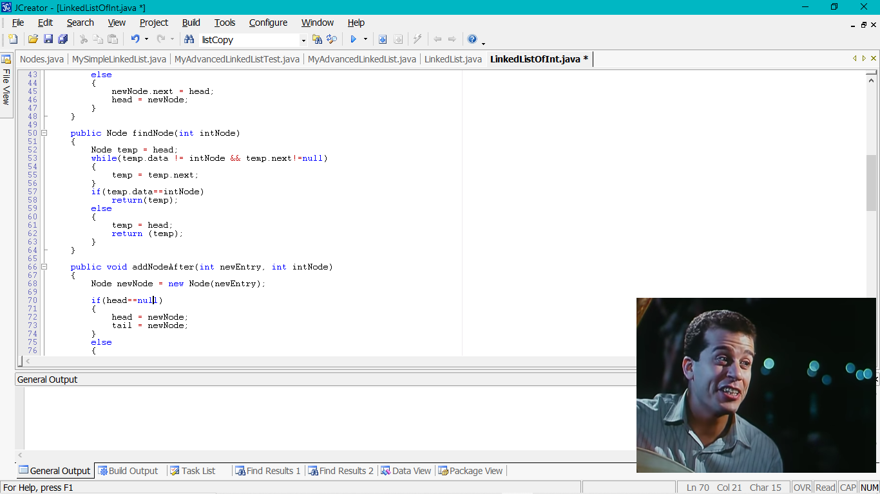
Add Node after specific element in the linked list (Cont.)
To add after specified element in the linked list, you have 2 ways:
add after specific number, so you need to find the number that you want to add after it.
Add in specific location, so you need to traverse the linked list nodes until you reach to the location that you want to add the element in it.

Slide 8
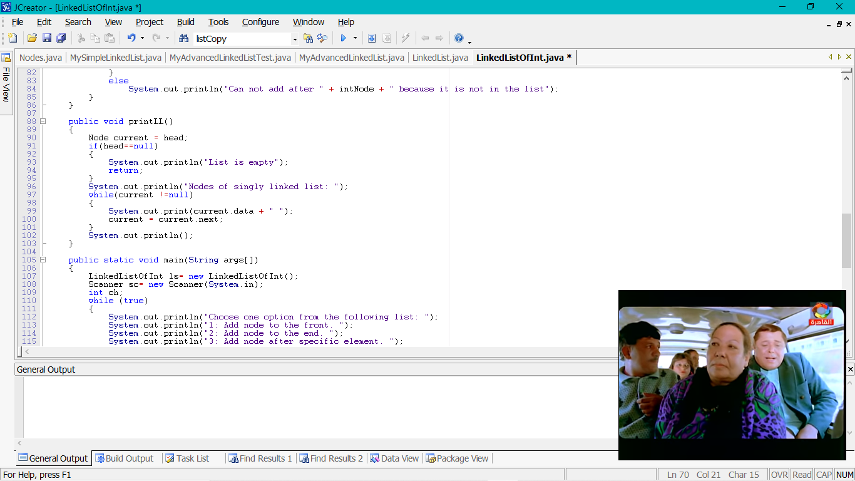
Print the elements of the linked list

Slide 9
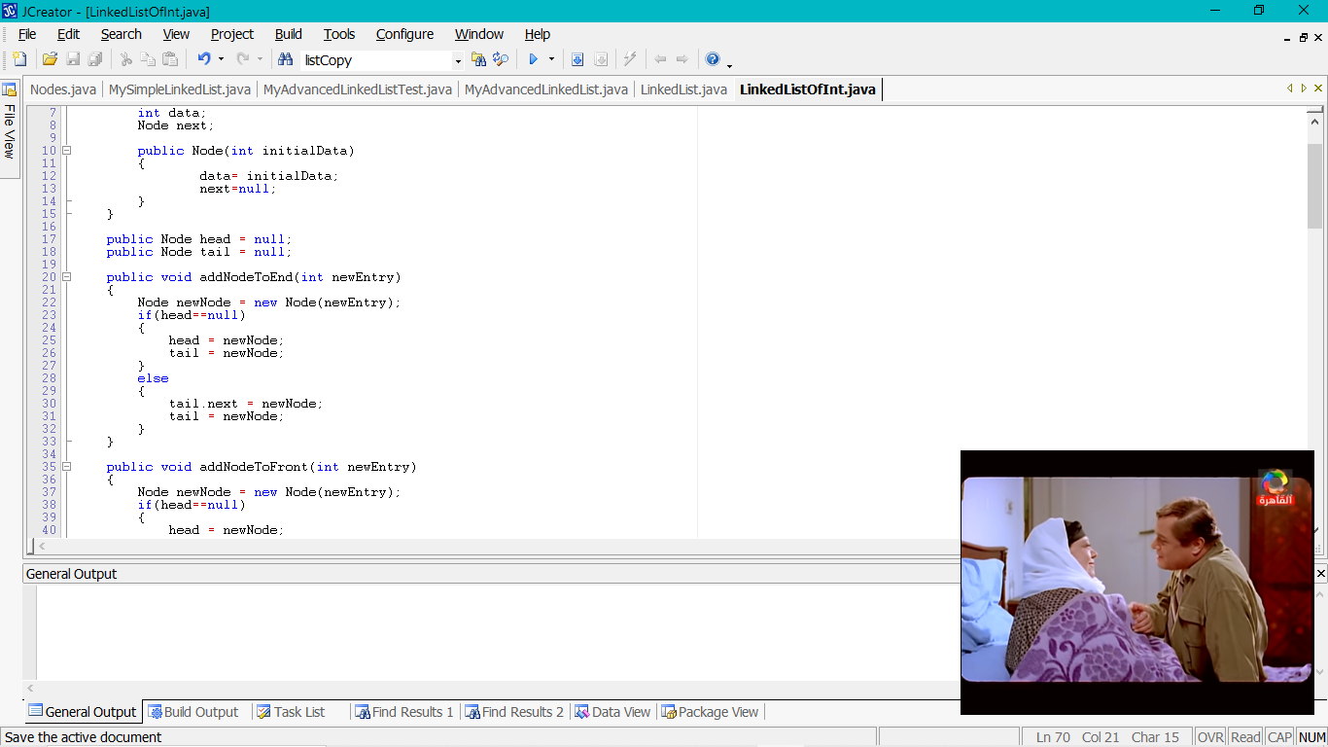
You need Node to point to the beginning of you Linked List

Slide 10
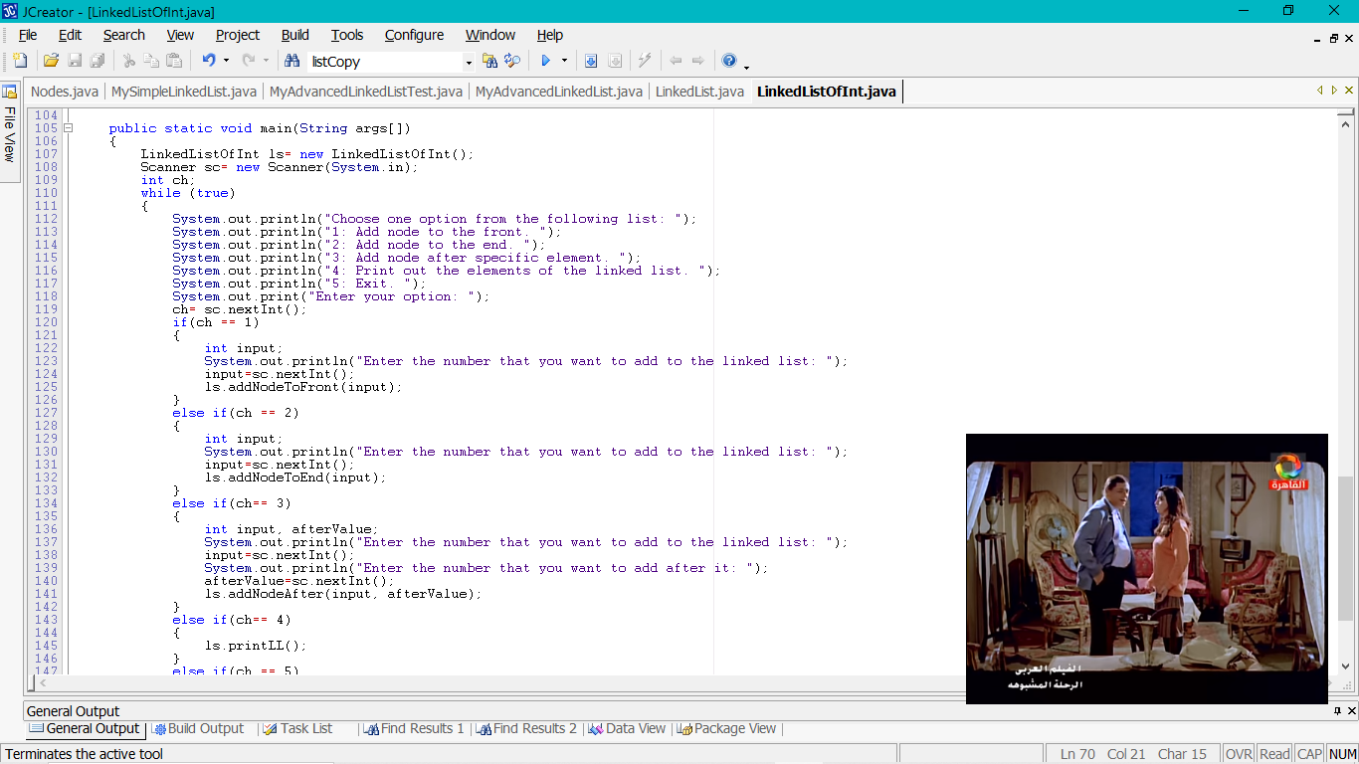
Main Method

Slide 11
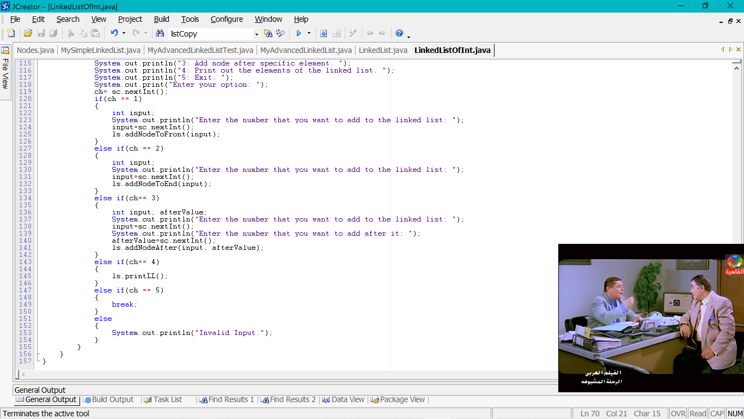
Main Method (Cont.)

Slide 12
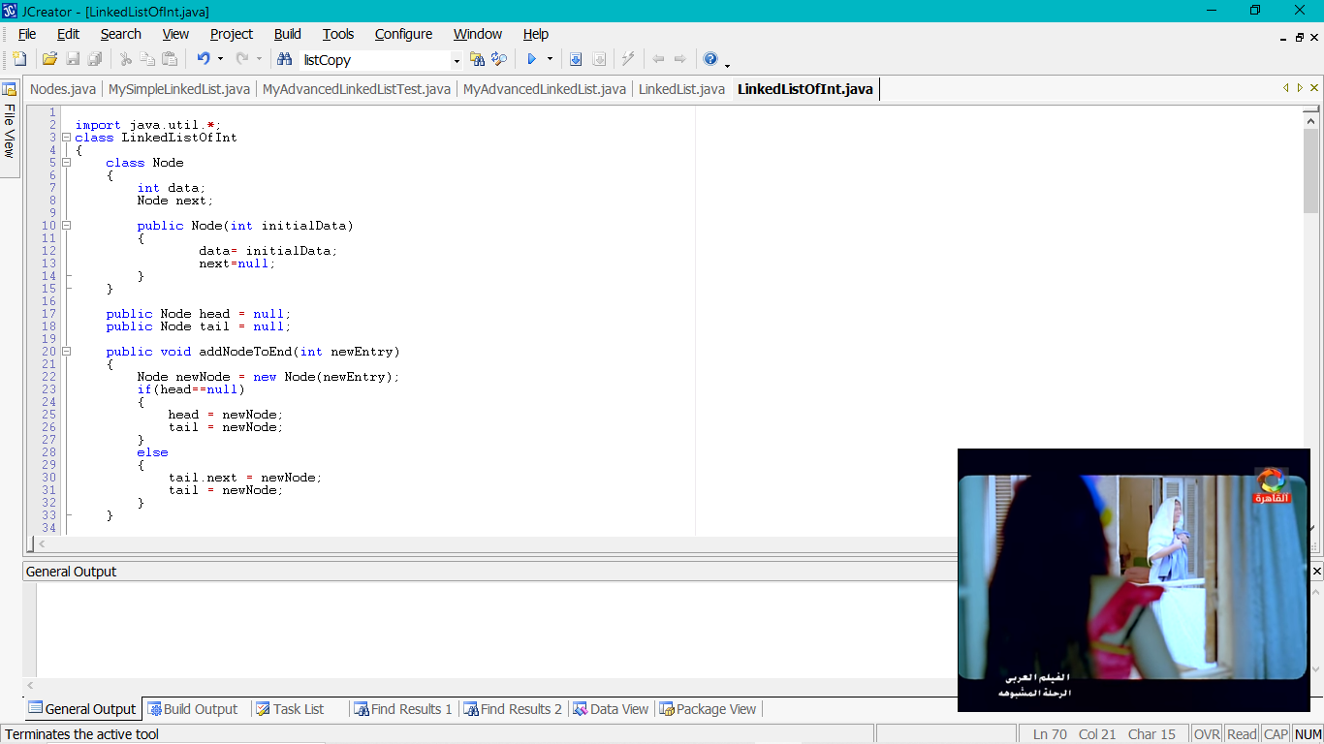
Put Node Class, Nodes, methods, and Main method in one class

Slide 13
Activity 1 & 2
Add the following methods to the program:
method to add node to the Linked List based on the location instead of adding after specific value.
method to remove the first node from the Linked List.

Slide 14
Homework Rules
for ADS Lab
The homework should be submitted on Saturday of each week.
Submit the homework to Ulearn.
One mark will be deducted for each day late submission.
You must do the homework by yourselves. In case of copy and paste the submission will not be considered and you need to do it again (Make mistakes and learn from them but don’t copy and paste).

Slide 15
Homework
To the same program add the following methods:
method to remove the last node from the linked list.
method to remove node with specific information.
Note: Do not forget to write the specification for your program.

Slide 16
SEE YOU NEXT WEEK

